Slide 1
UNIX SYSTEM PROGRAMMING
IPC - PIPE

Slide 2
Creating pipe
Pipe is a method of connecting standard output of one process to the standard input of another.
Pipes provide one-way communication(half-duplex).
Eg: ls | sort
The output of ls command (program) is passed as input to sort command (program)

Slide 3
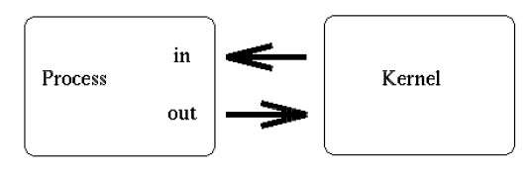
When a process creates a pipe, the kernel sets up two file descriptors for use by the pipe. One descriptor is used to allow a path of input into the pipe (write), while the other is used to obtain data from the pipe (read).

Slide 4
Creating pipe
int pipe(int fd[2]);
We need to pass array of 2 integers to pipe.
Fd[0] will be filled with file descriptor for reading.
Fd[1] will be filled with file descriptor for writing.
main()
{
int fd [2] = {0,0};
pipe( fd);
printf(" %d ",fd[0]);
printf(" %d " , fd[1]);
}
Notes:
Pipe1.c
Output : 3 , 4
main()
{
int pipefd [2] = {0,0};
#ifdef OPEN
open(__FILE__ , O_RDONLY);
#endif
pipe(pipefd);
printf(" %d %d \n",pipefd[0] , pipefd[1]);
}

Slide 5
Writing to and reading from pipe
int main()
{
int pipefd [2] = {0,0}, n;
pipe( pipefd) ;
char output[] = "hello world\n";
char input[20]= "SIKANDER";
write (pipefd[1],output, sizeof(output));
read ( pipefd[0] , input, sizeof (input)) ;
printf("String after read = %s ",input);
}
Notes:
Pipe2.c
At this point, the pipe is of little practical use, as the creating process can only use the pipe to communicate with itself.
main()
{
int pipefd [2] = {0,0}, n;
if( pipe( pipefd) == -1)
{
printf("can not create pipe \n");
return 1;
}
char output[] = "hello world\n";
char input[20]= "SIKANDER";
if (write (pipefd[1],output, sizeof(output))!= sizeof(output))
{
printf("pipe write error \n");
}
if( ( n = read ( pipefd[0] , input, sizeof (input) ) ) <= 0 )
{
printf("pipe read error \n");
}
puts(input);
}

Slide 6
Broken Pipe
Writing to a pipe where Read end is closed.
void myhandler(int signo) {
printf("SIGNAL HANDLER \n");
printf("Signal number = %d \n" , signo);
}
main( ) {
int pipefd [2] = {0,0};
pipe( pipefd) ;
signal(SIGPIPE , myhandler);
close(pipefd[0]);
if(write (pipefd[1],"hello ", 5)!= 5) {
printf("pipe write error \n");
}
}
Notes:
#include <stdio.h>
#include <stdlib.h>
#include <unistd.h>
#include <signal.h>
void myhandler(int signo)
{
printf("SIGNAL HANDLER \n");
printf("Signal number = %d \n" , signo);
}
main()
{
int pipefd [2] = {0,0}, n;
if( pipe( pipefd) == -1)
{
printf("can not create pipe \n");
return 1;
}
signal(SIGPIPE , myhandler);
#ifdef CLOSEREAD
close(pipefd[0]);
#endif
if(write (pipefd[1],"hello world\n", 12)!= 12)
{
printf("pipe write error \n");
}
}

Slide 7
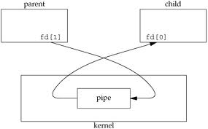
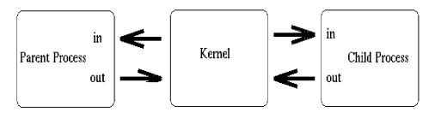
Creating a pipe to communicate within the same process is useless.
Pipe are used to communicate between parent and child process. Since a child process will inherit any open file descriptors from the parent, we now have the basis for multiprocess communication (between parent and child).
Notes:
At this point, the pipe is fairly useless. After all, why go to the trouble of creating a pipe if we are only going to talk to ourself? At this point, the creating process typically forks a child process. Since a child process will inherit any open file descriptors from the parent, we now have the basis for multiprocess communication (between parent and child).

Slide 8
Child Writes and Parent Reads
if(fork() == 0)
{
printf("CHILD WRITES \n");
write(fd[1], “SIKANDER” , 9);
}
else {
char input[20]= “";
if( ( n = read ( fd[0] , input, sizeof (input) ) ) > 0 )
printf("Parent read the data %s \n" , input);
}
Parent Writes and Child Reads
if(fork() == 0) {
char input[20]= "";
if( ( n = read ( fd[0] , input, sizeof (input) ) ) > 0 )
printf("Child read the data : %s \n" , input);
exit(0);
}
else{
write(fd[1], “SIKANDER” , 9);
}
Notes:
Pipechildparent.c

Slide 9
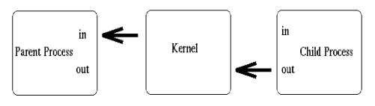
Generally, one process writes the data to pipe and other process reads data from pipe.
In which direction do we desire data to travel? Does the child process send information to the parent, or vice-versa?
The two processes mutually agree on this issue, and proceed to ``close'' the end of the pipe that they are not concerned with. For discussion purposes, let's say the child performs some processing, and sends information back through the pipe to the parent.
Notes:
Above, we see that both processes now have access to the file descriptors which constitute the pipeline. It is at this stage, that a critical decision must be made. In which direction do we desire data to travel? Does the child process send information to the parent, or vice-versa? The two processes mutually agree on this issue, and proceed to ``close'' the end of the pipe that they are not concerned with. For discussion purposes, let's say the child performs some processing, and sends information back through the pipe to the parent.
Construction of the pipeline is now complete! The only thing left to do is make use of the pipe. To access a pipe directly, the same system calls that are used for low-level file I/O can be used (recall that pipes are actually represented internally as a valid inode).
To send data to the pipe, we use the write() system call, and to retrieve data from the pipe, we use the read() system call. Remember, low-level file I/O system calls work with file descriptors! However, keep in mind that certain system calls, such as lseek(), do not work with descriptors to pipes.

Slide 10
main()
{
int fd [2] = {0,0}, n;
pipe( fd) ;
if(fork() == 0)
{
close(fd[0]); //Child Closes read
write(fd[1], “SIKANDER” , 9); // Parent Writes Data
exit(0);
}
char input[20]= “";
close(fd[1]); //Parent Closes write
if( ( n = read ( fd[0] , input, sizeof (input) ) ) > 0 )
printf(“ Parent process %s “ ,input));
}
Notes:
Pipeparentchild.c

Slide 11
2-way communication
Parent writes and child read
Child writes and parent reads
Parent
Child
0
1
2
P1- R 3
P1 - W 4 (X)
P2 – R 5 (X)
P2 – W 6
0
1
2
P1- R 3 (X)
P1 - W 4
P2 – R 5
P2 – W 6 (X)
Pipe p1
Pipe p2

Slide 12
#include <unistd.h>
int main()
{
int p1[2] = {0,0}, p2[2];
pipe(p1); pipe(p2);
if(fork() == 0)
{
printf("CHILD PROCESS \n");
close(p1[0]); close(p2[1]);
char cbuf[20] = " ";
write(p1[1], "HAI FROM CHILD" , 20);
read(p2[0] , cbuf , 20);
printf("child read %s \n",cbuf);
}
else
{
printf("PARENT PROCESS \n");
close(p1[1]); close(p2[0]);
char buffer[20];
buffer[read(p1[0] , buffer , 20)] = '\0';
printf("parent read : %s \n",buffer);
write(p2[1] ,”PARENT \n", 20);
}
}
Notes:
pipe2waycomm.c
#include <stdio.h>
#include <stdlib.h>
#include <unistd.h>
main()
{
int p1[2] = {0,0}, p2[2];
pipe(p1);
pipe(p2);
if(fork() == 0)
{
printf("CHILD PROCESS \n");
close(p1[0]);
close(p2[1]);
char cbuf[20] = "";
write(p1[1], "HAI FROM CHILD" , 20);
read(p2[0] , cbuf , 20);
printf("child read %s \n",cbuf);
}
else
{
printf("PARENT PROCESS \n");
close(p1[1]);
close(p2[0]);
char buffer[20];
buffer[read(p1[0] , buffer , 20)] = '\0';
printf("parent read : %s \n",buffer);
write(p2[1] ,"BYE FROM PARENT \n", 20);
}
return 0;
}

Slide 13
Implement command
ls | wc
int fd [2] = {0,0}, n;
pipe( fd) ;
if(fork() == 0)
{
close(fd[0]);
dup2(fd[1] , 1);
execlp("ls","ls",0);
}
else
{
close(fd[1]);
dup2(fd[0] , 0);
execlp("wc","wc",0);
}
Create a pipe.
Create a child process
Inside Child Process
Close read end of pipe
Redirect the stdout to fd[1]
Execute ls cmd using execlp
Inside Parent Process
Close write end of pipe
Redirect the stdin to fd[0]
Execute wc cmd using execlp
Notes:
We need to execute two commands (ls and wc). One process cannot execute two commands, we need to create child process.
Assume child execute ls and passes the ouput to pipe, parent reads the input from pipe and execute wc.
#include <stdio.h>
#include <stdlib.h>
#include <unistd.h>
main()
{
int fd [2] = {0,0}, n;
if( pipe( fd) == -1)
{
printf("can not create pipe \n");
return 1;
}
if(fork() == 0)
{
close(fd[0]);
dup2(fd[1] , 1);
execlp("ls","ls",0);
}
else
{
close(fd[1]);
dup2(fd[0] , 0);
execlp("wc","wc",0);
}
}

Slide 14
Implement command - Incomplete
ls | wc
First Child
Second Child
parent
0
1
2
3(dup – 0)
4(x)
5(x)
6(dup – 1)
0
1
2
3(x)
4(x)
5(dup – 0)
6(x)
Ls -l
Ls – l | head -4
Notes:
main()
{
int fd [2] = {0,0}, n;
if( pipe( fd) == -1)
{
printf("can not create pipe \n");
return 1;
}
if(fork() == 0)
{
close(fd[0]);
dup2(fd[1] , 1);
execlp("ls","ls","-l",0);
}
else
{
int fd1[2] = {0};
if(pipe(fd1) == -1)
printf("Cannot create 2nd pipe ");
if(fork() == 0)
{
close(fd[1]);
close(fd1[0]);
dup2(fd[0] , 0);
dup2(fd1[1] , 1);
execlp("head","head","-4",0);
}
else{
close(fd[0]); close(fd[1]);
close(fd1[1]);
dup2(fd1[0] , 0);
execlp("tail","tail","-1",0);
}
}
}

Slide 15
Implement command
ls | head -4 | tail -1
First Child
Second Child
parent
0
1
2
3 (x)
4(dup – 1)
0
1
2
3(dup – 0)
4(x)
5(x)
6(dup – 1)
0
1
2
3(x)
4(x)
5(dup – 0)
6(x)
Ls -l
Ls – l | head -4
Notes:
main()
{
int fd [2] = {0,0}, n;
if( pipe( fd) == -1)
{
printf("can not create pipe \n");
return 1;
}
if(fork() == 0)
{
close(fd[0]);
dup2(fd[1] , 1);
execlp("ls","ls","-l",0);
}
else
{
int fd1[2] = {0};
if(pipe(fd1) == -1)
printf("Cannot create 2nd pipe ");
if(fork() == 0)
{
close(fd[1]);
close(fd1[0]);
dup2(fd[0] , 0);
dup2(fd1[1] , 1);
execlp("head","head","-4",0);
}
else{
close(fd[0]); close(fd[1]);
close(fd1[1]);
dup2(fd1[0] , 0);
execlp("tail","tail","-1",0);
}
}
}

Slide 16
//Second Child
close(fd[1]);
close(fd1[0]);
dup2(fd[0] , 0);
dup2(fd1[1] , 1);
execlp("head","head","-4",0);
}
else{
//Parent
close(fd[0]); close(fd[1]);
close(fd1[1]);
dup2(fd1[0] , 0);
execlp("tail","tail","-1",0);
}
}
}
main()
{
int fd [2] = {0,0}, n;
pipe( fd);
if(fork() == 0)
{ //First Child
close(fd[0]);
dup2(fd[1] , 1);
execlp("ls","ls","-l",0);
}
else
{
int fd1[2] = {0};
pipe(fd1) ; if(fork() == 0)
{
//Second Child

Slide 17
Names Pipes
Unnamed Pipes – Cannot use open system call.
named Pipes – Can use open system call. (Can open but cannot create a file).
Unnamed and named has 2 file descriptors (read end and write end).
Write from one end and read from other end.
Named pipes also called FIFO
Destructive reading.
Persistency is different (File system persistency).
Can communicate between related and unrelated process.
File name will be stored permanently, data is temporary

Slide 18
Half duplex comm
Pipe size is 4kb
Blocking effect and broken pipe.

Slide 19
named Pipe
Creating Named Pipe from Command Prompt
Mknod filename p
Mkfifo filename
$mkfifo PIPE
prw-rw-r-- 1 sik sik 0 Sep 11 15:13 PIPE
Size of named pipe is always 0.
Type of file is p.
Cannot open file in vi editor / cat.
Notes:
Mknod can be used to create different device file. (p – pipe)

Slide 20
“
Creating Named Pipe using function calls.
int mkfifo(const char *path, mode_t mode);
int mknod(const char *path, mode_t mode, dev_t dev);
mkfifo(“PIPE“ , 0666);
mknod(“PIPE“ , S_IFIFO | 0666 , 0);

Slide 21
Named Pipe : Same Process
main()
{
mknod("mypipe",S_IFIFO | 0666 , 0);
if(fork() == 0)
{
int fd = open("mypipe",O_WRONLY);
printf("Child : Write mode : %d \n",fd);
write(fd,"HELLO",5);
}
else
{
char buff[6] = "";
int fd = open("mypipe",O_RDONLY);
printf("Parent : Read mode : %d \n",fd);
buff[read(fd , buff , 5)] = '\0';
printf("Message read = %s " , buff);
}
}
Notes:
#include <fcntl.h>
#include <sys/types.h>
#include <sys/stat.h>
main()
{
int fd;
printf("Retval mknod %d \n",mknod("mypipe",S_IFIFO | 0666 , 0));
if(fork() == 0)
{
fd = open("mypipe",O_WRONLY);
printf("Child : Write mode : %d \n",fd);
write(fd,"HELLO",5);
}
else
{
char buff[6] = "";
fd = open("mypipe",O_RDONLY);
printf("Parent : Read mode : %d \n",fd);
buff[read(fd , buff , 5)] = '\0';
printf("Message read = %s " , buff);
}
}

Slide 22
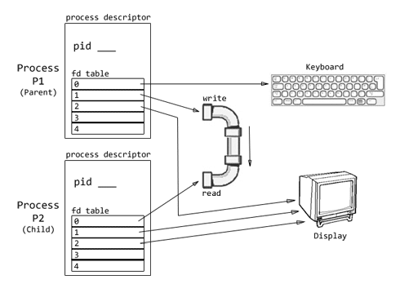

Slide 23
What is a pipe?
How to create a unnamed pipe?
What are the drawbacks of unnamed pipe?
How to create a named pipe?
Is the pipe created in parent, accessible in child process?
If u create a child process, does the pipe get duplicated?

